Slide 1
Analysis of IBM HR Attrition Data
Understanding Employee Attrition and Satisfaction
Presented by: Madalina Bituleanu, Alexandra Bucuresteanu.
7th of June 2024

Slide 2
BUSINESS GOAL - EMPLOYEE’S ATTRITION AND PERFORMANCE ANALYSIS
Project overview:
The objective of this project is to gain insights into the factors influencing employee attrition and performance within the organisation by performing data analysis on the HR dataset.
Analyse the current level of attrition.
Determine the attrition rate and the factors influencing it?
How does gender play a part in job retention?
Corelation between variables and factors influencing attrition
Are leavers more dissatisfied with their jobs and work life balance?
How does salary/monthly income impact attrition rate?
Some recommendations to improve employee retention.
Tools used in this project are POWER BI and PYTHON.

Slide 3
Introduction
Attrition is described as the gradual loss of employees over time.
Attrition is a major issue for all organizations, where it can lead to implications in staffing, employee morale, project costs, loss of experience, and a general hindrance to organizational growth.
Employee capital is one of the greatest assets an organization can possess. Companies can spend as much as 70% of total business costs on employees.
In the field of Human Resources, HR, when employees decide to quit, this is referred to as employee attrition, and this is the focus of our analysis.
We see that there is overlapping evidence for why employees decide to leave, where in most cases it is due to the following reasons: unsatisfying compensation, unsatisfactory benefits, lack of growth or development opportunities, issues with work-life balance, poor management, poor work conditions, and lack of recognition for work accomplishments or value added in the workplace.

Slide 4
Overview of Data
This dataset is known on Kaggle as the IBM HR Analytics Employee Attrition & Performance dataset. It is comprised of over one thousand and four hundred observations and thirty-five features—features and variables is used interchangeably in this report to represent the columns for which observations pertain to.
Within the dataset we have a mix of numeric and categorical datatypes. The initial dataset contains thirty/continuous variables like monthly income, distance from home, job level and it contains 5 categorical data types like education field, gender, department.
It is important to verify the construction of the dataset and its variable types. This is because the make-up of the data directly influences the nature of what is possible in the analysis process. We used Python to clean up the data and look for null and duplicate values

Slide 5
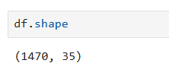
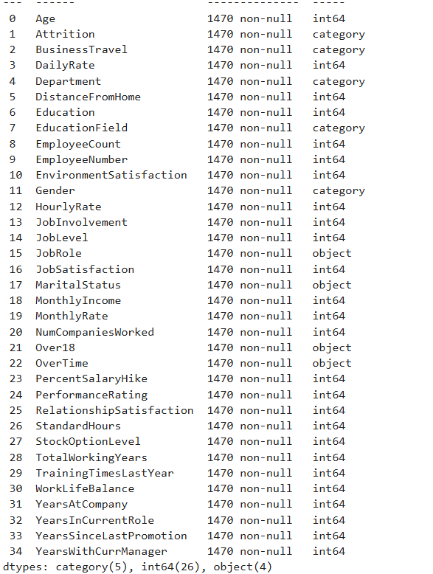
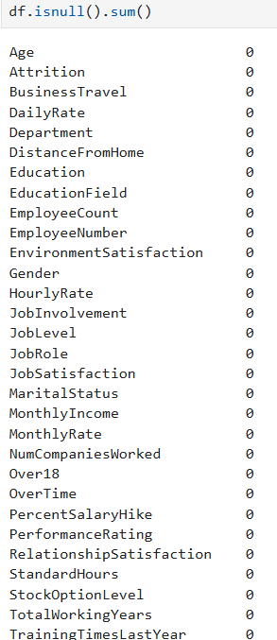
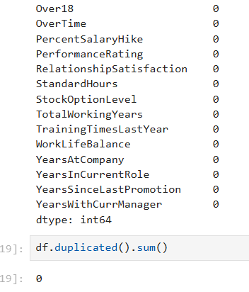
Python Data Analysis

Slide 6
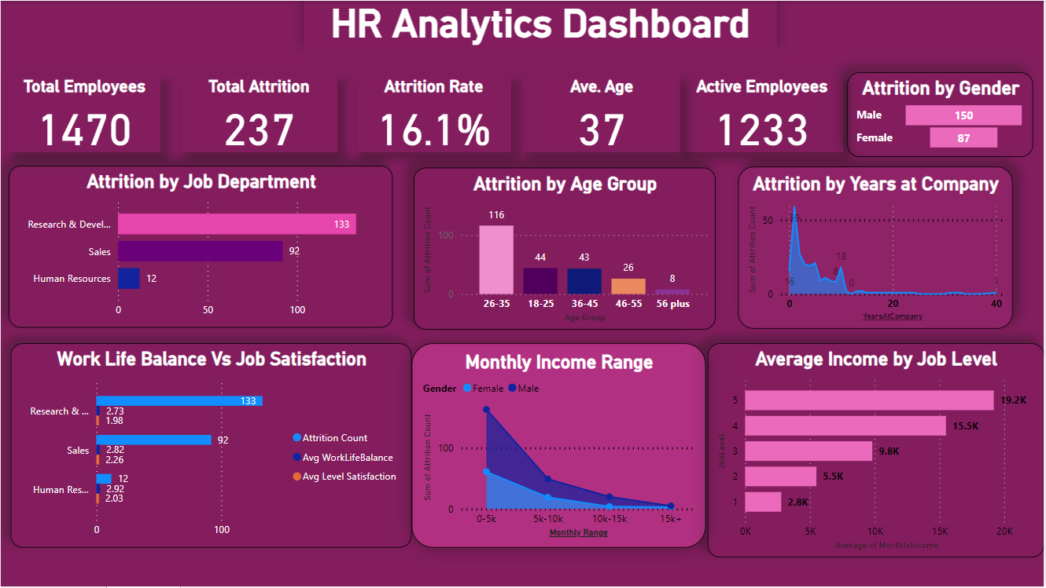

Slide 7
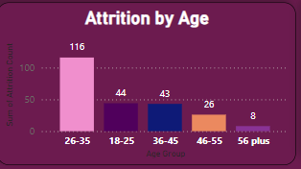
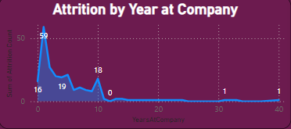
Age Group vs Years in the Company
The age range within this dataset is between 18 to 60
Above it is illustrated the graphic of the attrition rate along with an employee’s age. We see how between the ages of 26 and 35, there is a major increase in attrition while as the years continue the attrition rate is significantly lower. This same pattern is apparent when looking at the years worked by employees. We notice that the first three years of employment incur the highest attrition rates

Slide 8
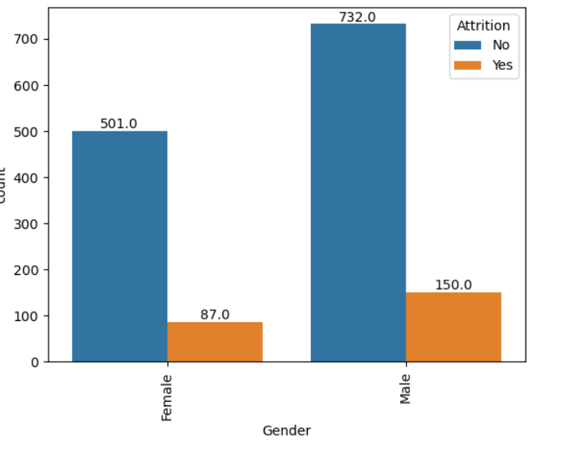
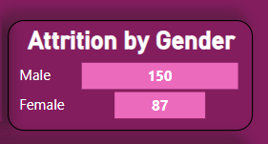
Attrition by Gender
When analysing attrition by gender, we do see a greater proportion of men leaving the company vs women.
Out of the 1470 total employees in the company, 150 men out of 882 decided to leave and out of 588 women, 87 women quit the company.

Slide 9
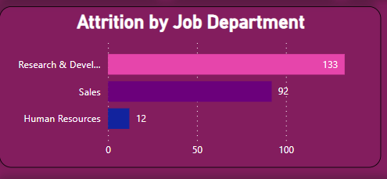
Attrition by Job Department
The highest attrition is in Research and Development (133) while the lowest is in the Human Resource department (only 12).
The department with the second attrition number looks to be in Sales with 92 of employees leaving.

Slide 10
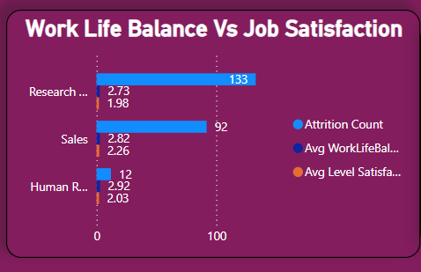
Work life Balance vs Job Satisfaction
The department with the lowest work life balance of 2.73 and a job level satisfaction of only 1.98 out of 4 is the Research Department. Being the department with the highest number of employee leaving, this indicates that work life balance and job level satisfaction play a significant role in why some employees are leaving.
The department with the highest work life balance is the Human Resources department, with an average of 2.92 out of 4. Since this is the department with the lowest attrition count (12), we can confidently say that work life balance is crucial to job retention.

Slide 11
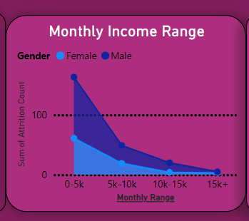
Attrition by Income Range
The highest attrition rate is within the 0-5k monthly salary range, with 163 employees, dropping to 49 employees within the 5k-10k and down to only 5 in the 15k+ range. This indicates that salary does play a major role and is highly correlated with the number of employees who leave the company.
At the same time, there seem to be more male than females who decide to leave due to low salary.

Slide 12
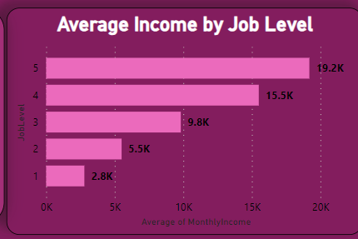
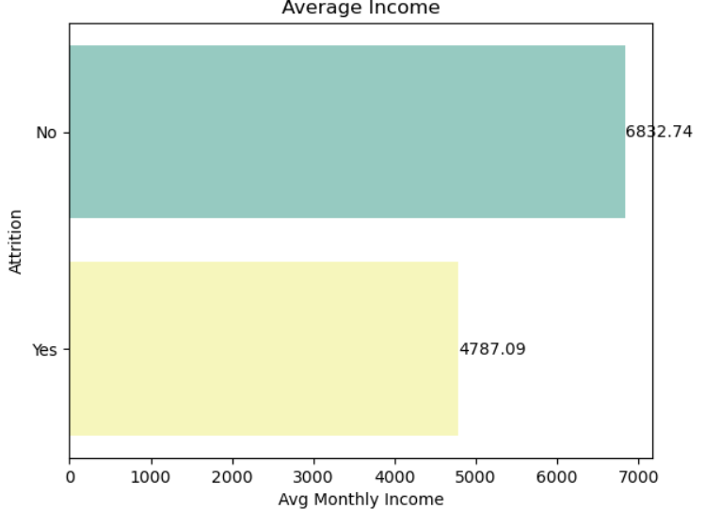
Attrition vs Job Level and Cutoff Salary
From this graph we can see that job level is correlated with a higher income, with an average salary for top management positions of 19.K (level 5) while for lower positions, the average is around 2.8K. This is important, because from the second graph, we see the average cutoff salary for attrition of about 4.7K, while for no attrition, around 6.8K, indicating that attrition is more predominant in the lower job levels.

Slide 13
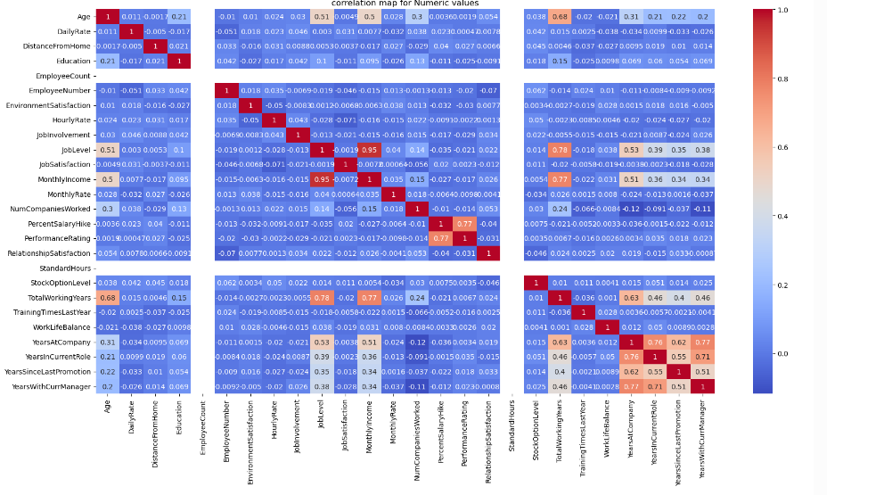
Correlations
Monthly Income
!!Lower Attrition!!
Job Level
Total Working Years
YearsAtCompany

Slide 14
Conclusions
High attrition rates indicate potential underlying issues.
Poor work-life balance and job satisfaction are key factors in determining why some employees leave
Younger employees are at higher risk of resigning.
Age and Years spent in the company (total working years) have a high correlation with attrition
Lower attrition rate correlates with experience and years spent working in the company, which in turn leads to higher income levels and higher job satisfaction

Slide 15
- Recommendations -
Improve work-life balance with flexible working options, such as telecommuting options or flexible hours, to help employees better manage their work-life balance.
Provide career development programs and growth opportunities for employees at all career stages, from freshers to long-serving staff. This can improve skills, job satisfaction, and retention rates.
Enhance job satisfaction through regular feedback and recognition programs.
Conduct exit interviews to gather insights and continuously improve.
Mentorship and Support: Establish mentorship programs to help new employees, including freshers, acclimate to the organization. Providing guidance and support can improve their job satisfaction and long-term commitment

Slide 16
- Recommendations -
Pay Equity: Address the income disparity observed between employees leaving and staying in the company. Investigate potential pay gap issues to ensure fair compensation practices across all levels.
Experience Spectrum: Recognize attrition trends at both ends of the experience spectrum, with employees completing 20 years + of service and freshers (0-3 years) leaving the company. Tailor retention strategies to address specific concerns of these groups.

Slide 17
Sources
Kaggle
Predicting Employee attrition (IBM dataset) (kaggle.com)
Understanding Employee Attrition: Meaning, Causes, and Strategies (peoplebox.ai)

